Slide 1
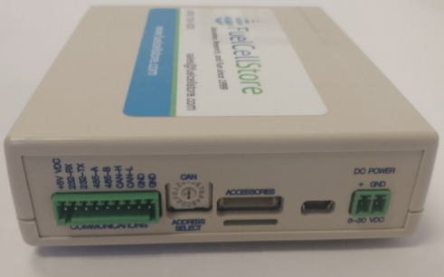
Team 36:
Fuel Cell Monitor
Update Presentation 03/28
Nolan Kao
Mingoo Jung
John Henderson
TA: Max Lesser
Sponsor: John Lusher

Slide 2
Project Overview
The Fuel Cell Monitor (FCM) will be able to monitor up to sixteen cell voltages simultaneously and display them on a mobile application.

Slide 3
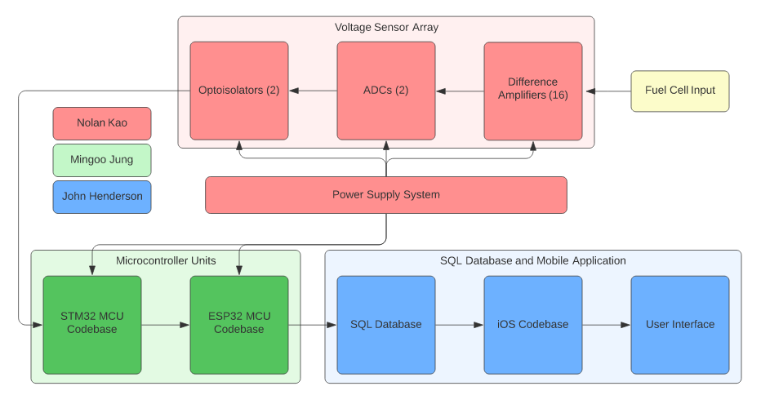
FCM System Diagram

Slide 4
Power Supply / Voltage Sensor Array (VSA) Characteristics
Wall plug delivers 5VDC to power supply.
Power supply delivers 5VDC to sixteen difference amplifiers and two ADCs in VSA.
Power supply delivers 3.3VDC to 2 optoisolators, STM32 MCU, and ESP32 MCU in VSA.

Slide 5
Update on Power Supply and Voltage Sensors (VSA)
Nolan Kao
Accomplishments since last update 36 hours of effort | Ongoing progress/problems and plans until next presentation
Board is fully soldered. | Troubleshoot power supply voltage readings and implement test solution. Test MCU functionality with Mingoo..

Slide 6
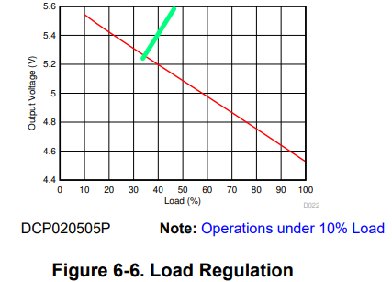
DCP020505U/1K Troubleshooting
According to datasheet, 5.8V at the output corresponds to approximately no load at all. However, measurements seem to differ by a lot from the following isolation tests.
Note: DCP020505P and DCP020505U are to be treated as having the same graph.

Slide 7
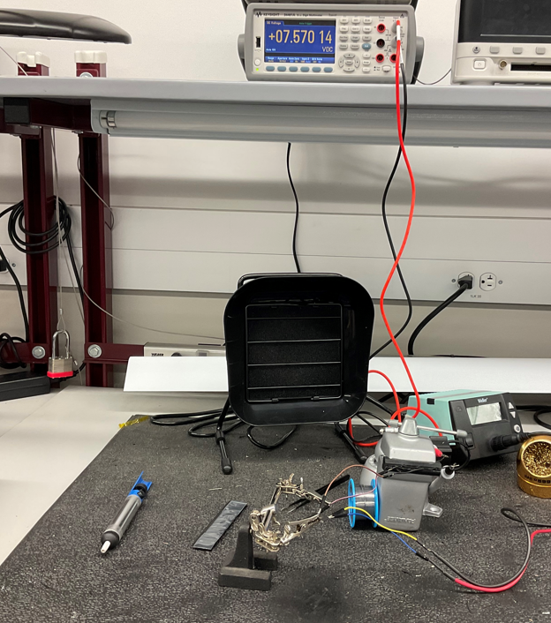
Isolation testing with no load:
Testing resistive loads (or in this case, no load) to see resultant output voltage from the DCP020505U/1K

Slide 8
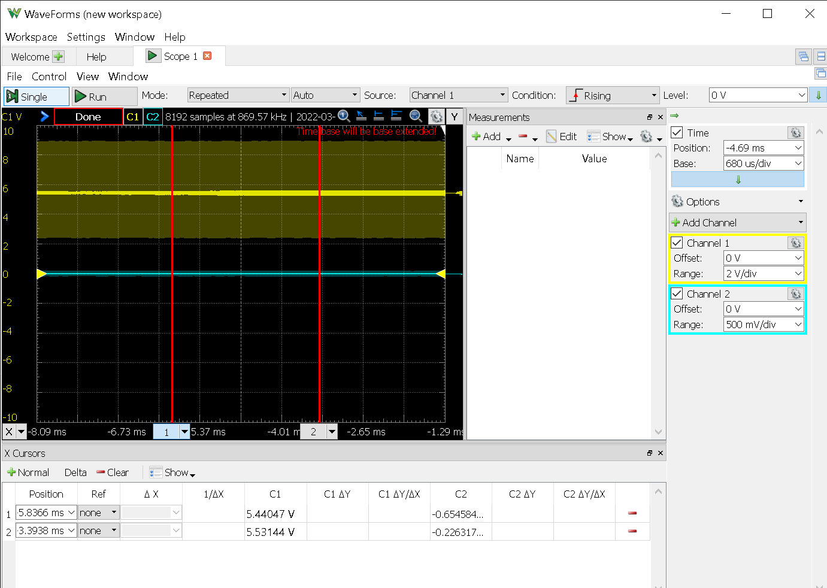
Isolation testing with a load of 500 ohms:
Testing resistive loads to see resultant output voltage from the DCP020505U/1K

Slide 9
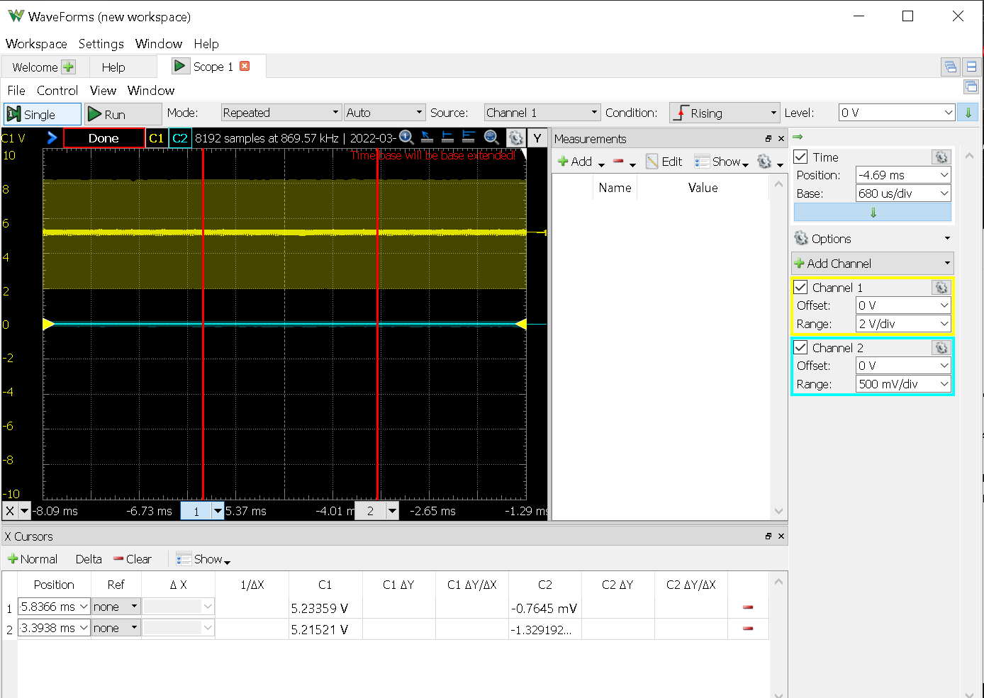
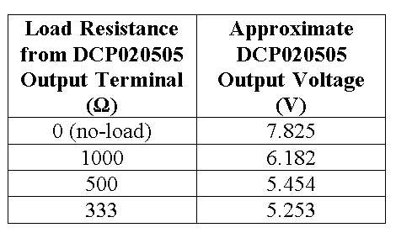
Notes:
Trying to get the equivalent resistance from the output of the DCP020505 to ~330 ohms.

Slide 10
DCP020503P Troubleshooting
Same case for 3.3V output node of DCP020503P
PCB voltage reads 3.8V at output. Recommended voltage is 3.6V or lower.
Must bring down equivalent resistance at output node to lower the voltage.

Slide 11
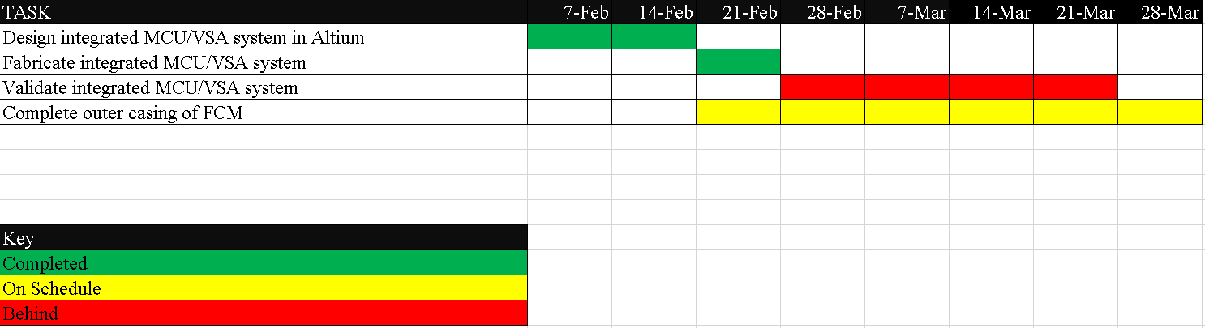
MCU/VSA Schedule

Slide 12
Update on MCU Subsystem
Accomplishments since last update 35 hrs of effort | Ongoing progress/problems and plans until next presentation
Modified code for transmission of 16-bit data Add loop code for transmitting 16 set of buffers Building new MCU subsystem circuit | Final test for integration between the Communication MCU and Mobile Application Finalize build new MCU subsystem circuit with prototype PCB board

Slide 13
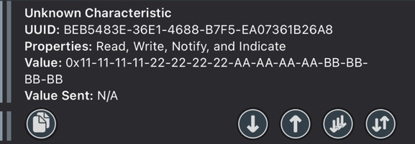
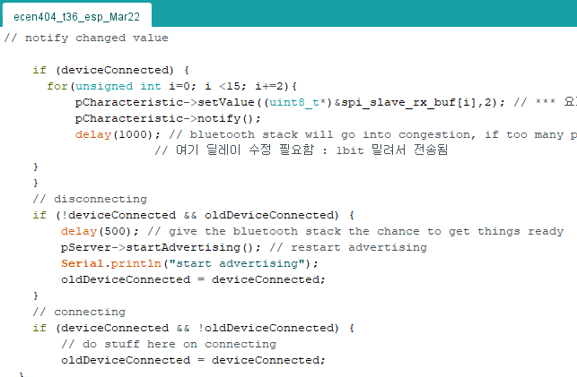
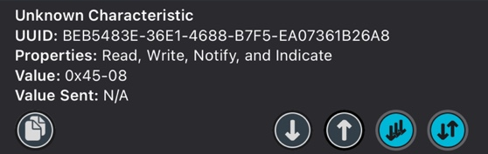
Figure1-1. Transmit stacked voltage data together
Figure1-2. Transmit each voltage data respectively
Figure2. ‘for’ loop for making data flow

Slide 14
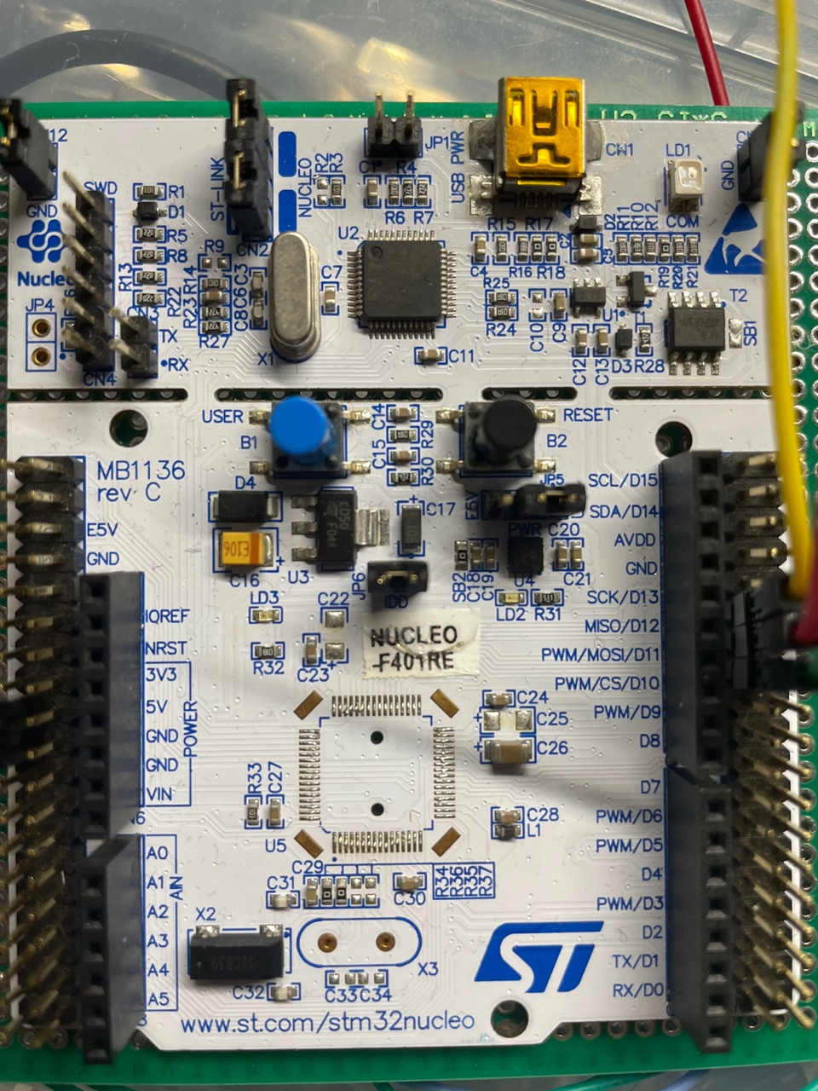
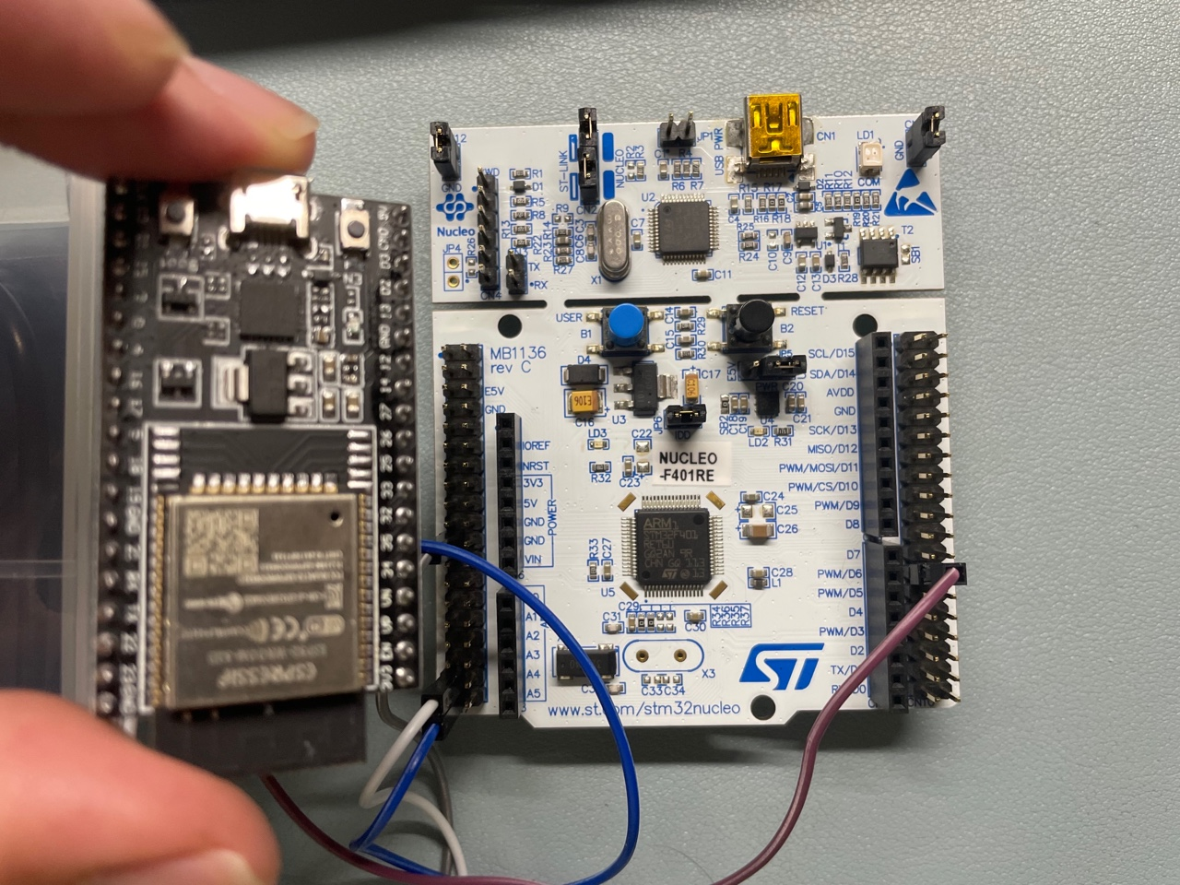
Figure3-1. Desoldered IC (STM32) from the MCU subsystem and implement
Figure3-2. Order new modules and build MCU system on prototype pcb board

Slide 15
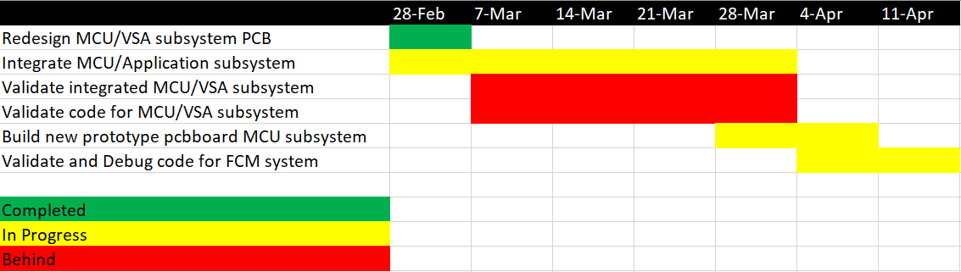
MCU Schedule

Slide 16
Update on SQL Database and Mobile App
Accomplishments since last update 40 hrs of effort | Ongoing progress/problems and plans until next presentation
App can connect to device to device and read from characteristics | Updating the database using values from bluetooth Connect to the rest of the characteristics

Slide 17
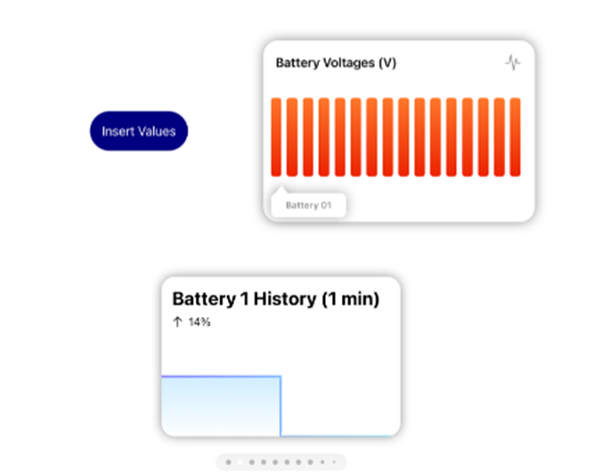

Slide 18
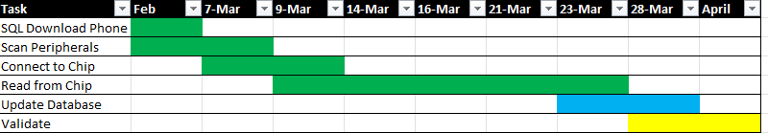
Mobile App Schedule

Slide 19
Thanks for listening!

